Slide 1

ATHLETE
H
A
HUB
I
AI-assisted athlete performance &
biomechanical risk assessment
B
A practical system for turning training videos and athlete data into movement insights that are easy to understand.
R
Presented by
[Neelakantha Panigrahi]
PROJECT PRESENTATION | M1–M4
ATHLETE HUB • M1–M4
01

Slide 2
01 • OVERVIEW
What is Athlete Hub?
The idea is simple: make movement analysis easier to access, easier to understand, and useful for day-to-day training.
1
ATHLETE
The project in one sentence
Athlete Hub brings athlete profiles, training data and video-based movement analysis into one place.
↓
2
VIDEO
↓
3
POSE
• Athletes can upload a training video instead of relying only on manual observation.
• The system extracts body landmarks and turns them into measurable movement metrics.
• Those metrics feed an explainable risk and recommendation layer.
↓
4
ANALYSIS
↓
5
INSIGHT
From raw footage to a result the athlete can act on.
ATHLETE HUB • M1–M4
02

Slide 3
02 • PROBLEM
Why did we build it?
The project focuses on a gap between what athletes record and what they can actually learn from that data.
What makes the problem difficult
The question we are answering
• Movement quality is often judged by eye, so small asymmetries can be missed.
• Training load, fatigue and previous injury history are rarely considered
together.
• Raw measurements are not very helpful unless they are explained in a simple way.
• Professional movement assessment can require time, equipment and expert availability.
How can we use an athlete's training video and available data to give useful, explainable movement and risk insights?
Goal
Turn complex analysis into feedback an athlete can understand.
ATHLETE HUB • M1–M4
03

Slide 4
03 • OBJECTIVES
What are we trying to achieve?
The objectives were kept practical: build the platform first, then make the analysis meaningful.
01
Build the platform
02
Handle training videos
Profiles, authentication, database and athlete dashboard.
Upload, store and process exercise recordings.
03
Measure movement
04
Explain risk
Extract pose landmarks and calculate biomechanical metrics.
Combine movement, injury, workload and fatigue indicators.
05
Give useful feedback
Detect anomalies and turn them into clear recommendations.
The result is not meant to replace a clinician; it is designed to support screening, discussion and training decisions.
ATHLETE HUB • M1–M4
04

Slide 5
04 • ARCHITECTURE
How the system works
A simple pipeline connects the web application to pose estimation, analytics and the final dashboard.
Athlete
Web App
FastAPI
Backend
Video
Processing
MediaPipe
Pose
Biomechanical
Analytics
Risk +
Recommendations
Dashboard
& Reports
Frontend
Backend
Computer Vision
Data
React + Vite
FastAPI + SQLAlchemy
MediaPipe + OpenCV
SQLite / PostgreSQL support
ATHLETE HUB • M1–M4
05

Slide 6
05 • IMPLEMENTATION
What we completed in M1–M4
Each milestone added one layer to the same working system.
M1
M2
M3
M4
Foundation
Video pipeline
Pose + biomechanics
Intelligence layer
Authentication, athlete profiles, database, dashboard and core API.
Training-video upload, storage and processing workflow.
Real MediaPipe Pose Landmarker processing and movement metrics.
Risk scoring, anomaly detection, injury-risk indicators and recommendations.
COMPLETED
COMPLETED
COMPLETED
COMPLETED
M1 → M2 → M3 → M4
The project is now at the point where the complete analysis flow can be demonstrated.
ATHLETE HUB • M1–M4
06

Slide 7
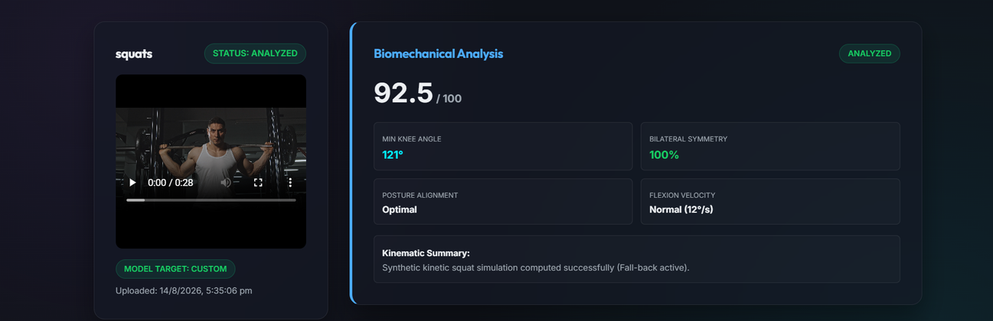
06 • M3
From video to movement data
This is the computer-vision part of the project: the system watches the movement frame by frame instead of treating the video as a black box.
What the system extracts
1
Knee angles
Track flexion and extension across frames.
2
Bilateral symmetry
Compare left and right movement.
3
Posture alignment
Look for meaningful positional deviation.
4
Flexion velocity
Estimate how quickly the movement changes.
Actual biomechanical analysis screen from the project
5
Skeletal landmarks
Use body keypoints as the basis for analysis.
Example: a squat video becomes structured movement data that the M4 intelligence layer can use.
ATHLETE HUB • M1–M4
07

Slide 8
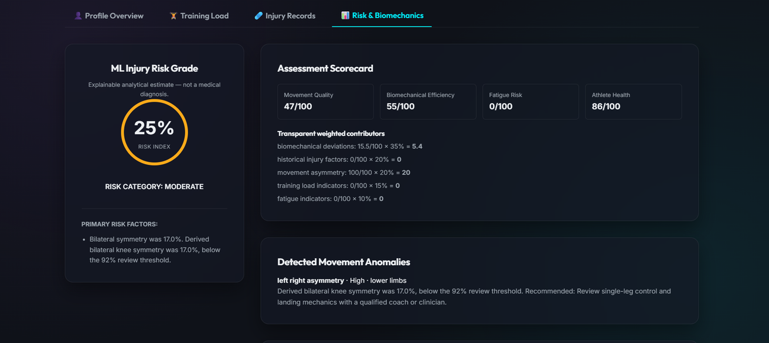
07 • M4
Risk assessment with transparent scoring
The result is deliberately explainable: the dashboard shows where the risk score came from instead of giving only a final number.
Demo result • Video 3
RISK INDEX
MOVEMENT
25.4
46.5
Moderate
/ 100
HEALTH
SYMMETRY
86.0
17.0
/ 100
review flag
Weighted model
35% biomechanics • 20% injury history • 20% asymmetry
15% training load • 10% fatigue
Actual Risk & Biomechanics screen for the demo athlete
Analytical estimate — not a medical diagnosis.
ATHLETE HUB • M1–M4
08

Slide 9
08 • M4 RESULTS
What did the system actually find?
The demo output shows both the warning signals and the action the athlete can take next.
Injury-risk indicators
Detected anomaly
ACL injury risk
59.5%
HIGH
LEFT–RIGHT ASYMMETRY • HIGH
Ankle sprain risk
62.6%
HIGH
Hamstring risk
8.9%
LOW
Lower-limb symmetry was measured at 17%, below the 92% review threshold.
Shoulder risk
12.1%
LOW
Recommendation
Lower-back risk
16.9%
LOW
Add supervised single-leg control and landing-mechanics drills.
Overuse risk
8.9%
LOW
ACWR: 1.0 • Status: Optimal
ATHLETE HUB • M1–M4
09

Slide 10
09 • CLOSING
Future upgrades
Thanks for reviewing — the work through M1–M4 stands as a finished deliverable .
If we continue
• Improve biomechanical accuracy and validation.
• Support more exercises and movement patterns.
• Expand training-load and athlete history data.
• Improve video visualization and reporting.
• Explore richer ML models and larger datasets.
• Move toward real-time analysis and deployment.
ATHLETE HUB • M1–M4
ATHLETE HUB • M1–M4
10

Slide 11
Questions & Discussion
THANK YOU
ATHLETE HUB • M1–M4
ATHLETE HUB • M1–M4
11

